Slide 1

Influence of Tractor Speed and Boom Height on Spray Coverage
Eric P. Prostko¹, Glen C. Rains², and O. Wen Carter¹
¹Dept. Crop & Soil Sciences
²Dept. of Entomology
UGA - Tifton

Slide 2
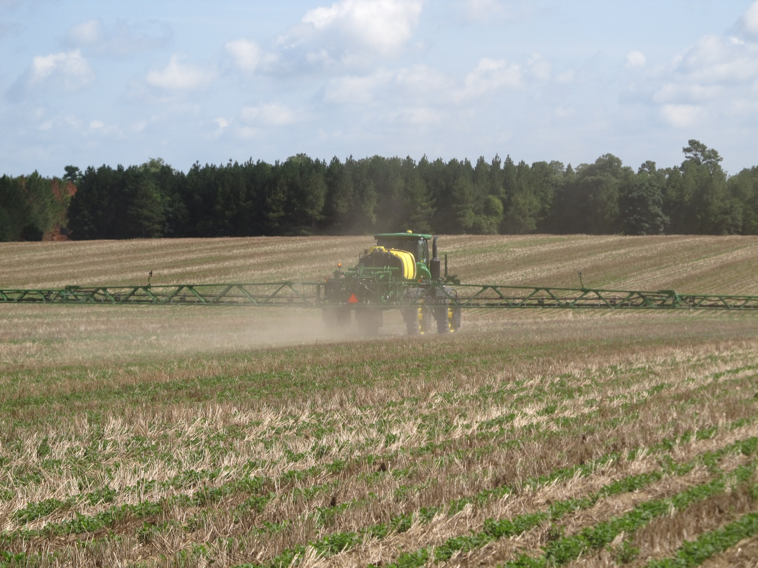
The New Norm????

Slide 3
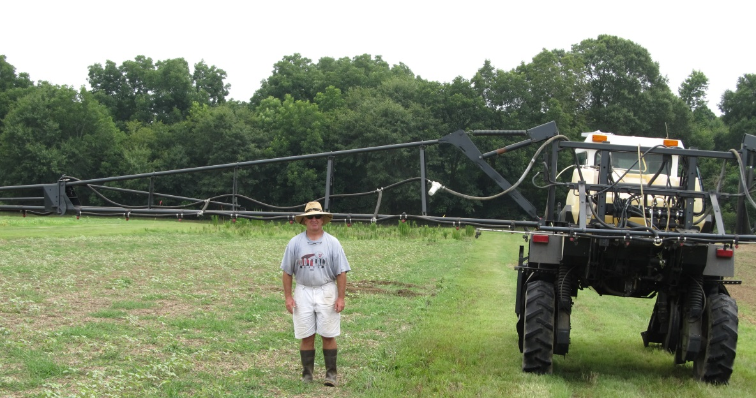
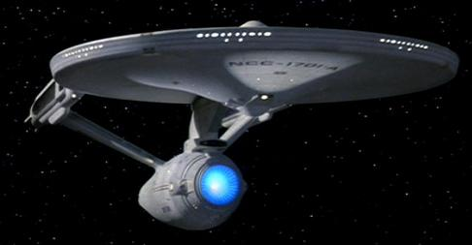
Is this a bad combination????
6 ft

Slide 4
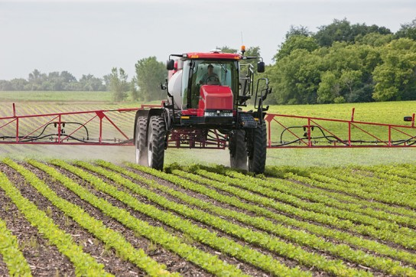
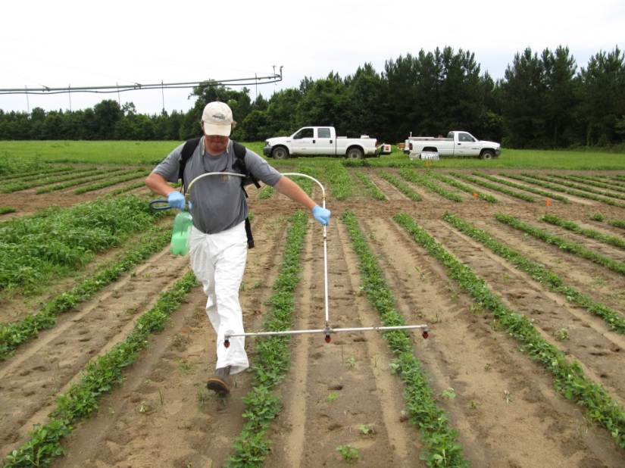
Farm vs. Research?
Concerns
Tractor Speed
Boom Height
Coverage
Quality vs. Quantity?

Slide 5
Herbicide Efficacy
Coverage
Nozzle Type
GPA
Pressure
Boom Height
Tractor Speed

Slide 6
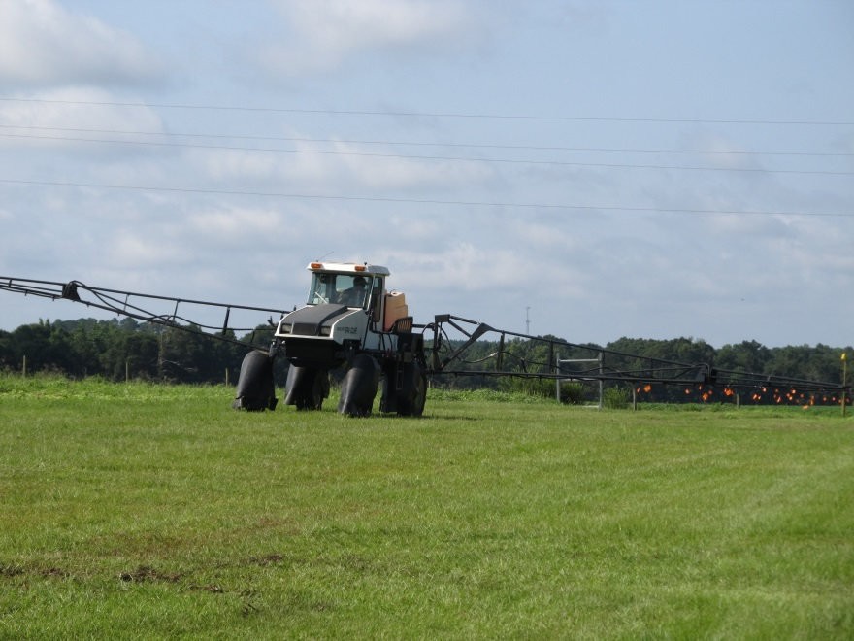
Objective
Evaluate the effects of tractor speed and boom height on spray quality
  Coverage
  VMD₅₀

Slide 7
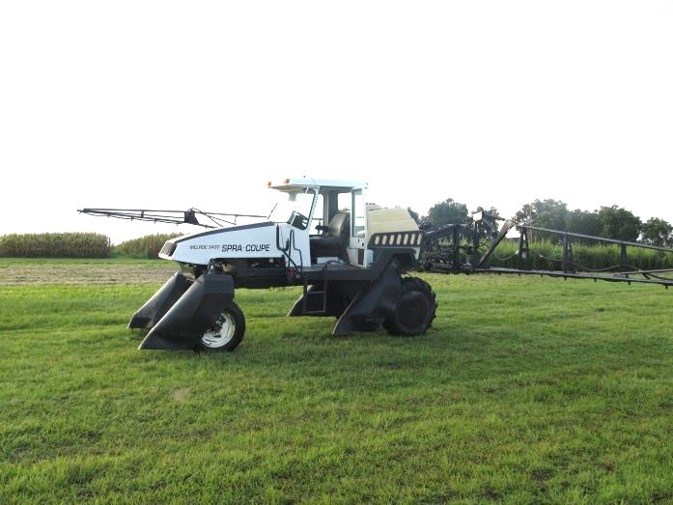
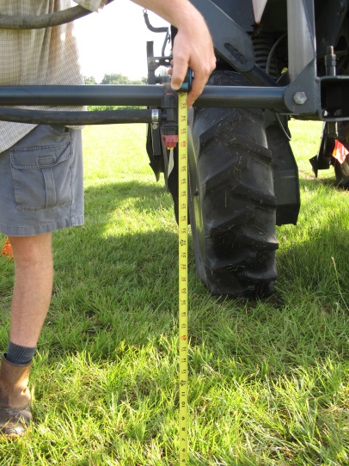
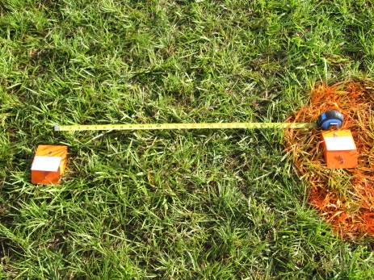
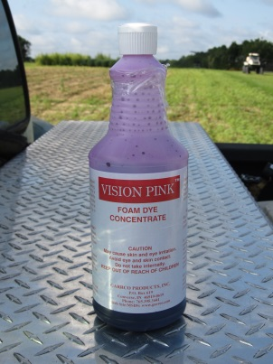
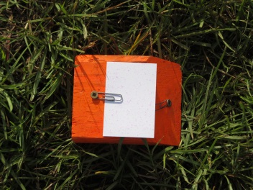
Materials and Methods
Melroe 3430 Spra-Coupe
Tractor Speeds
  4.4, 6.5, and 9.5 MPH
Boom Heights
  30, 45, 60 in
  Wind ≤ 3.0 MPH
15 GPA (water + dye)
DG TeeJet Drift Guard Nozzle Tips (20” spacing)
  8002DG (50 PSI)
  8003DG (40 PSI)
  8004DG (53 PSI)
    Medium Droplet Sizes
2 locations in sprayer path
  8’ from tractor center (L1)
  30” parallel from L1 (L0)
5 Kromekote cards (2” X 3”)
  10’ apart
Dropletscan (WRK of Arkansas, LLC)

Slide 8
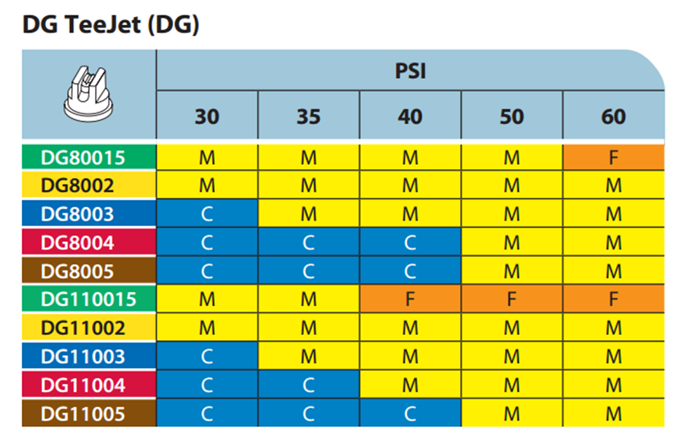
Droplet Size - TeeJet

Slide 9
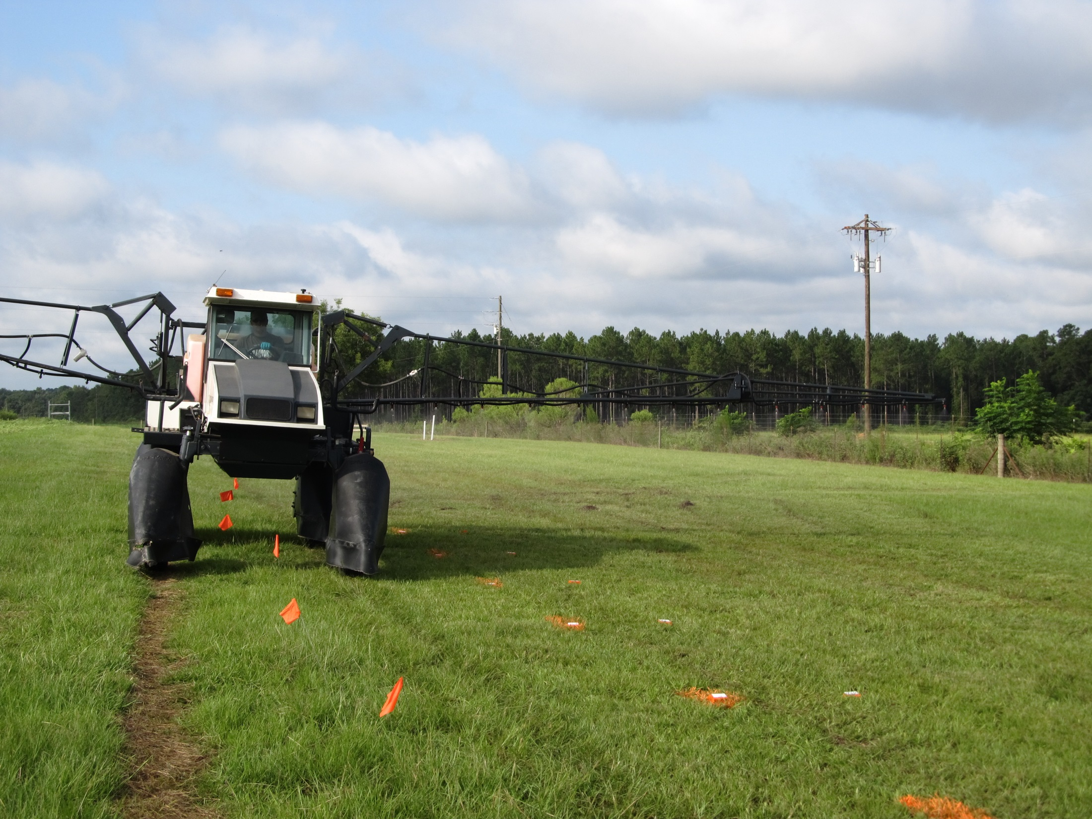
8’
10’
30”

Slide 10

Results
Analyzed data as 2 X 3 X 3 factorial
  2 card locations
    5 cards
  3 speeds
  3 boom heights
90 total data points
Speed X Boom Height interaction for Coverage and VMD₅₀

Slide 11
Influence of Tractor Speed and Boom Height on Spray Coverage (%)
LSD 0.10 = 1
CV = 12.523

Slide 12
Tractor Speed Effects on Spray Coverage (%) – 30” Boom Height
N = 30

Slide 13
Tractor Speed Effects on Spray Coverage (%) – 45” Boom Height
N = 30

Slide 14
Tractor Speed Effects on Spray Coverage (%) – 60” Boom Height
N = 30

Slide 15
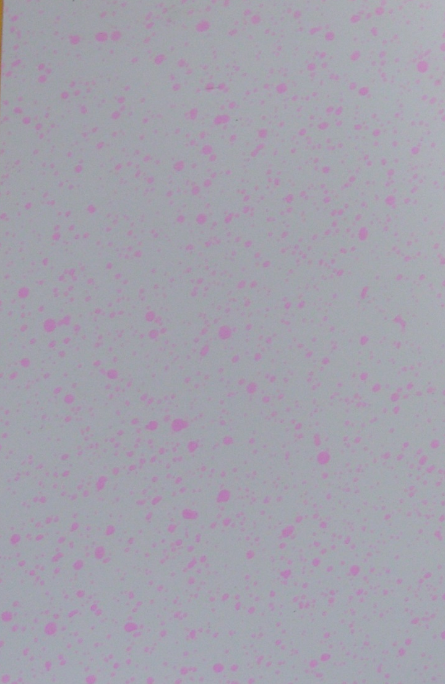
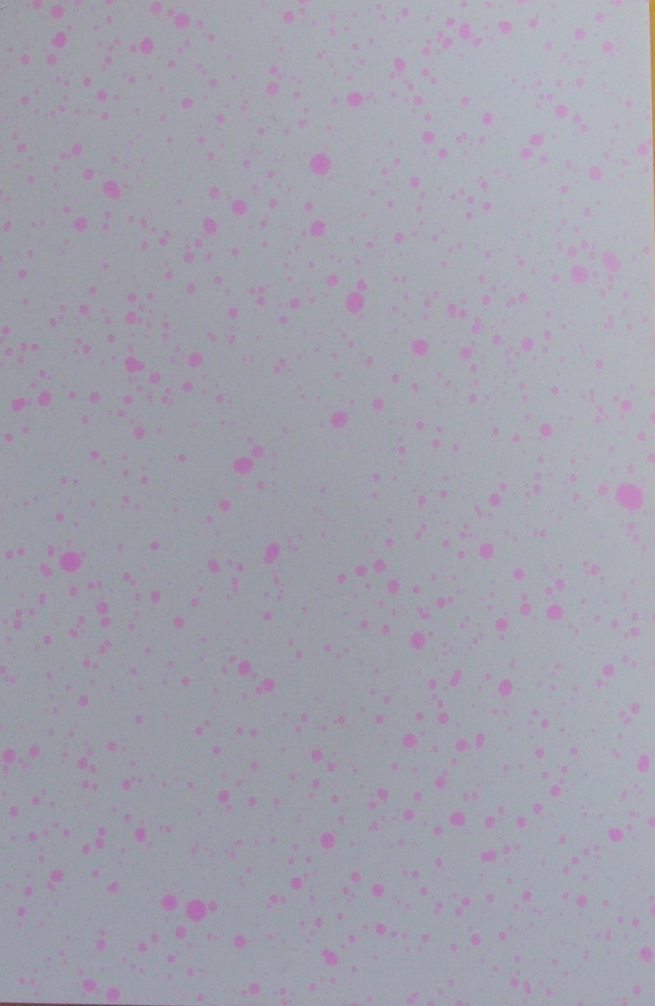
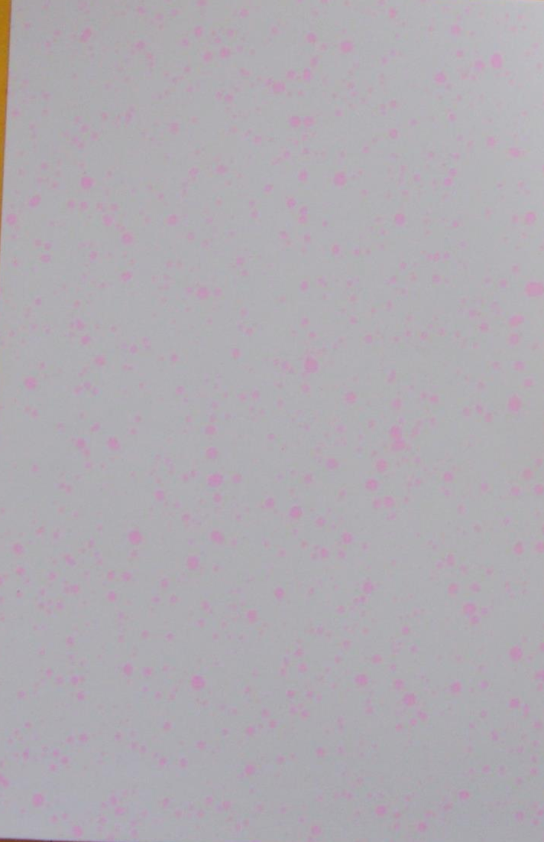
Spray Coverage - 60” Boom Height
4.4 MPH
6.5 MPH
9.5 MPH

Slide 16
Influence of Tractor Speed and Boom Height on Droplet Size (VMD₅₀)
Medium =
236-340 VMD₅₀
LSD 0.10 = 5
CV = 1.83

Slide 17
Summary – Tractor Sprayer
Lowest coverage at all boom heights was at 9.5 MPH tractor speed (6-8%)
For 30” and 60” boom heights, negative linear relationship between tractor speed and coverage (R² > 0.68)
  ~ 1.2% loss in coverage for each MPH
Boom height influenced spray coverage as follows:
  4.4 MPH: 30” = 60” > 45”
  6.5 MPH: 30” = 45” = 60”
  9.5 MPH: 45” > 30” = 60”
Generally, VMD₅₀ increased with tractor speed
  30” boom: 4.4 MPH < 6.5 MPH < 9.5 MPH
  45” boom: 4.4 MPH < 6.5 MPH = 9.5 MPH
  60” boom: 4.4 MPH < 9.5 MPH < 6.5 MPH
  306 to 345 microns (coarse droplet size)

Slide 18
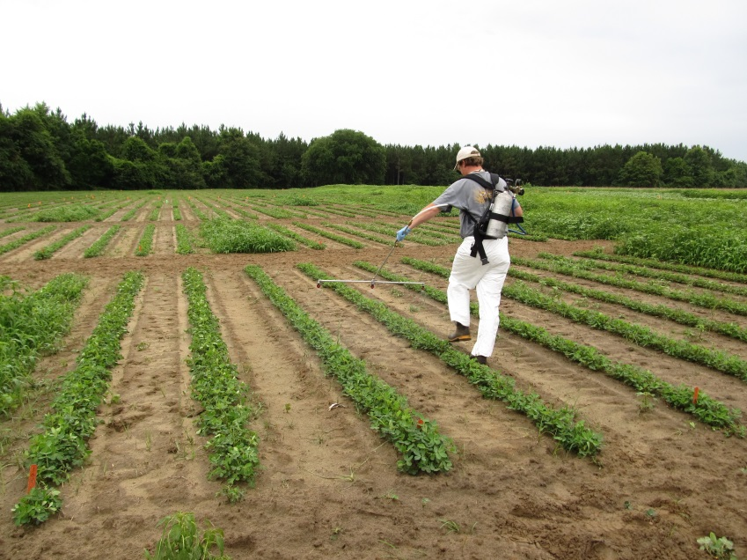
BackPack Sprayer Coverage Evaluation
Generally, same MM as tractor study
September 1, 2015
15 GPA
3 nozzle boom, 20” spacing
20” Boom Height
3.5 MPH (walking)
Wind (<1 MPH)
35-40 PSI
3 nozzle types
  11002DG
  AIXR 11002
  TTI02

Slide 19
The Influence of Nozzle Type on Spray Coverage (%) and VMD₅₀ (microns)
LSD 0.10 = 1.8
CV = 18.3
LSD 0.10 = 19
CV = 6
3.5 MPH - Walking
20” nozzle spacing
20” boom height
35-40 PSI
15 GPA

Slide 20
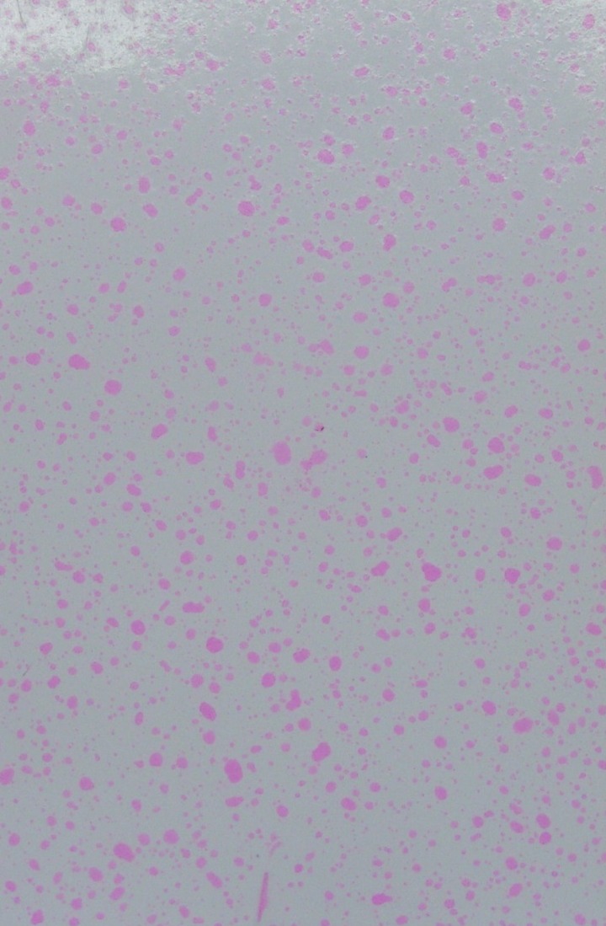
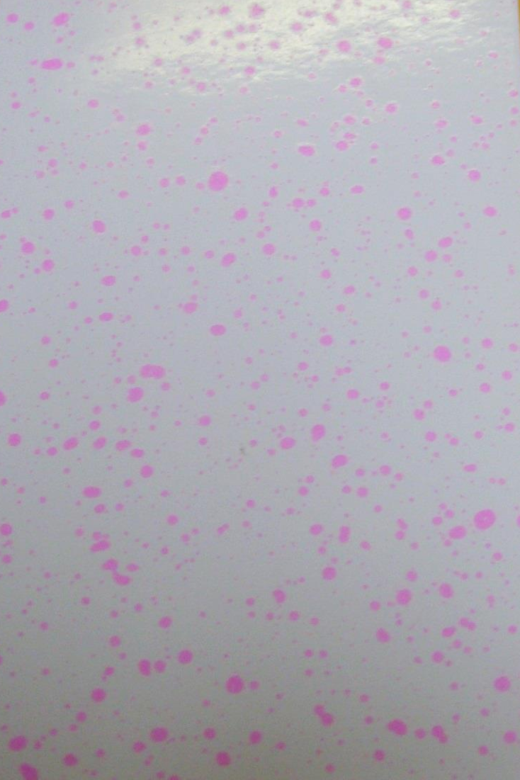
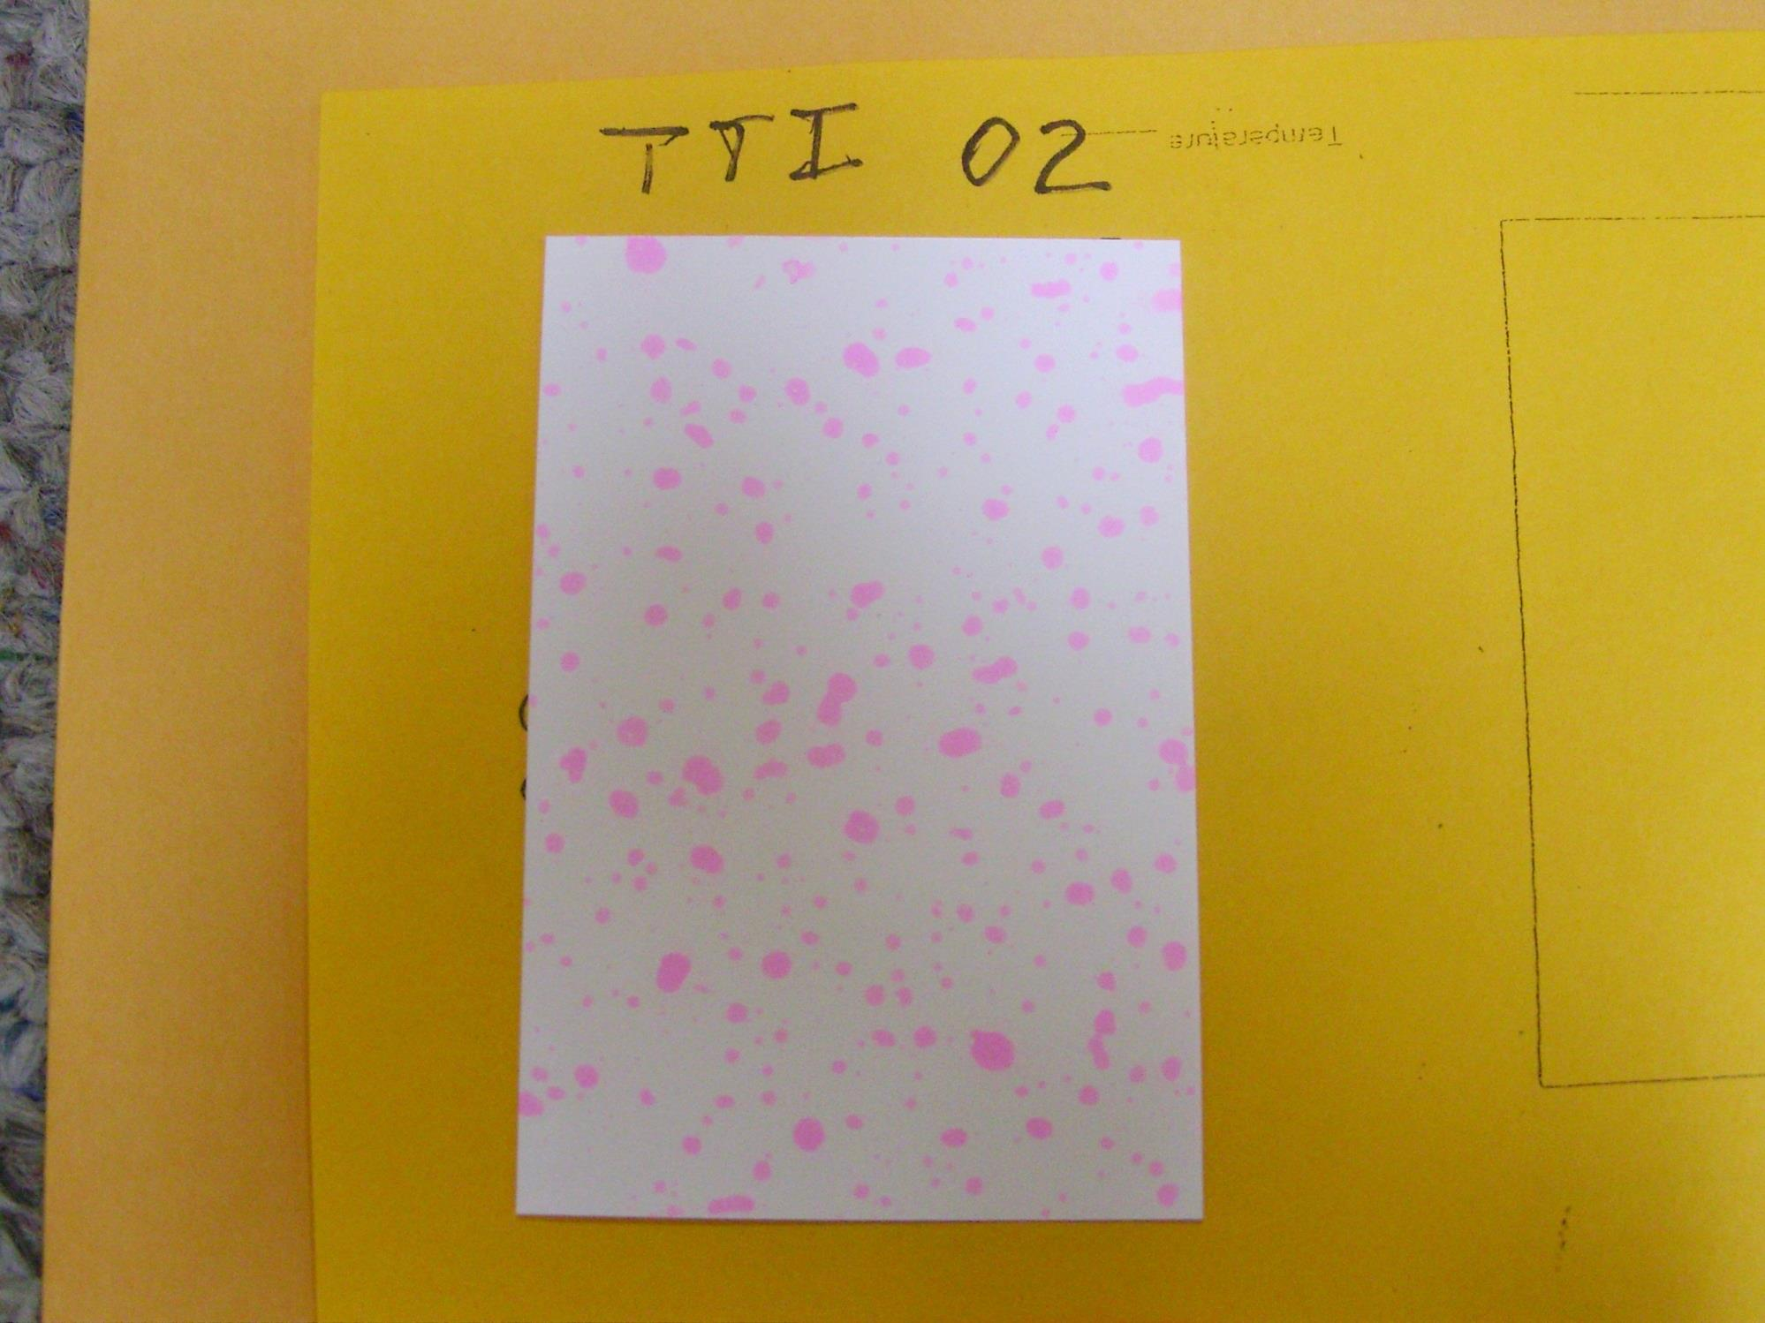
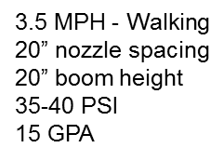
11002DG
VMD₅₀ = 322 (C
AIXR 11002
VMD₅₀ = 402 (VC)
TTI 02
VMD₅₀ = 524 (XC)

Slide 21
Final Thoughts
If a grower would drive 4.4-6.5 MPH, not much difference between backpack and tractor.
If grower drives 9.5 MPH or greater (?), ~50% less spray coverage.
Could this partially explain observed differences between research and on-farm results???
Farmer Resistance?
  Too big/late, too fast, too high?????

Slide 22
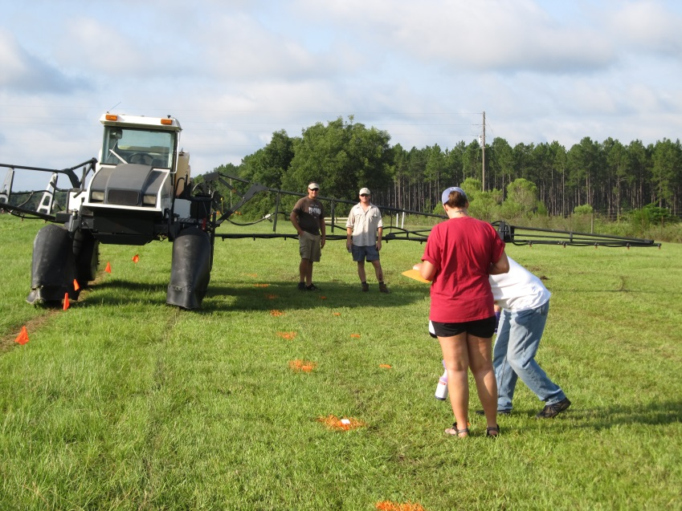
Acknowledgements
Technical Support provided by
  Tim Richards
  Charlie Hilton
  Maryssa Davis

Slide 23
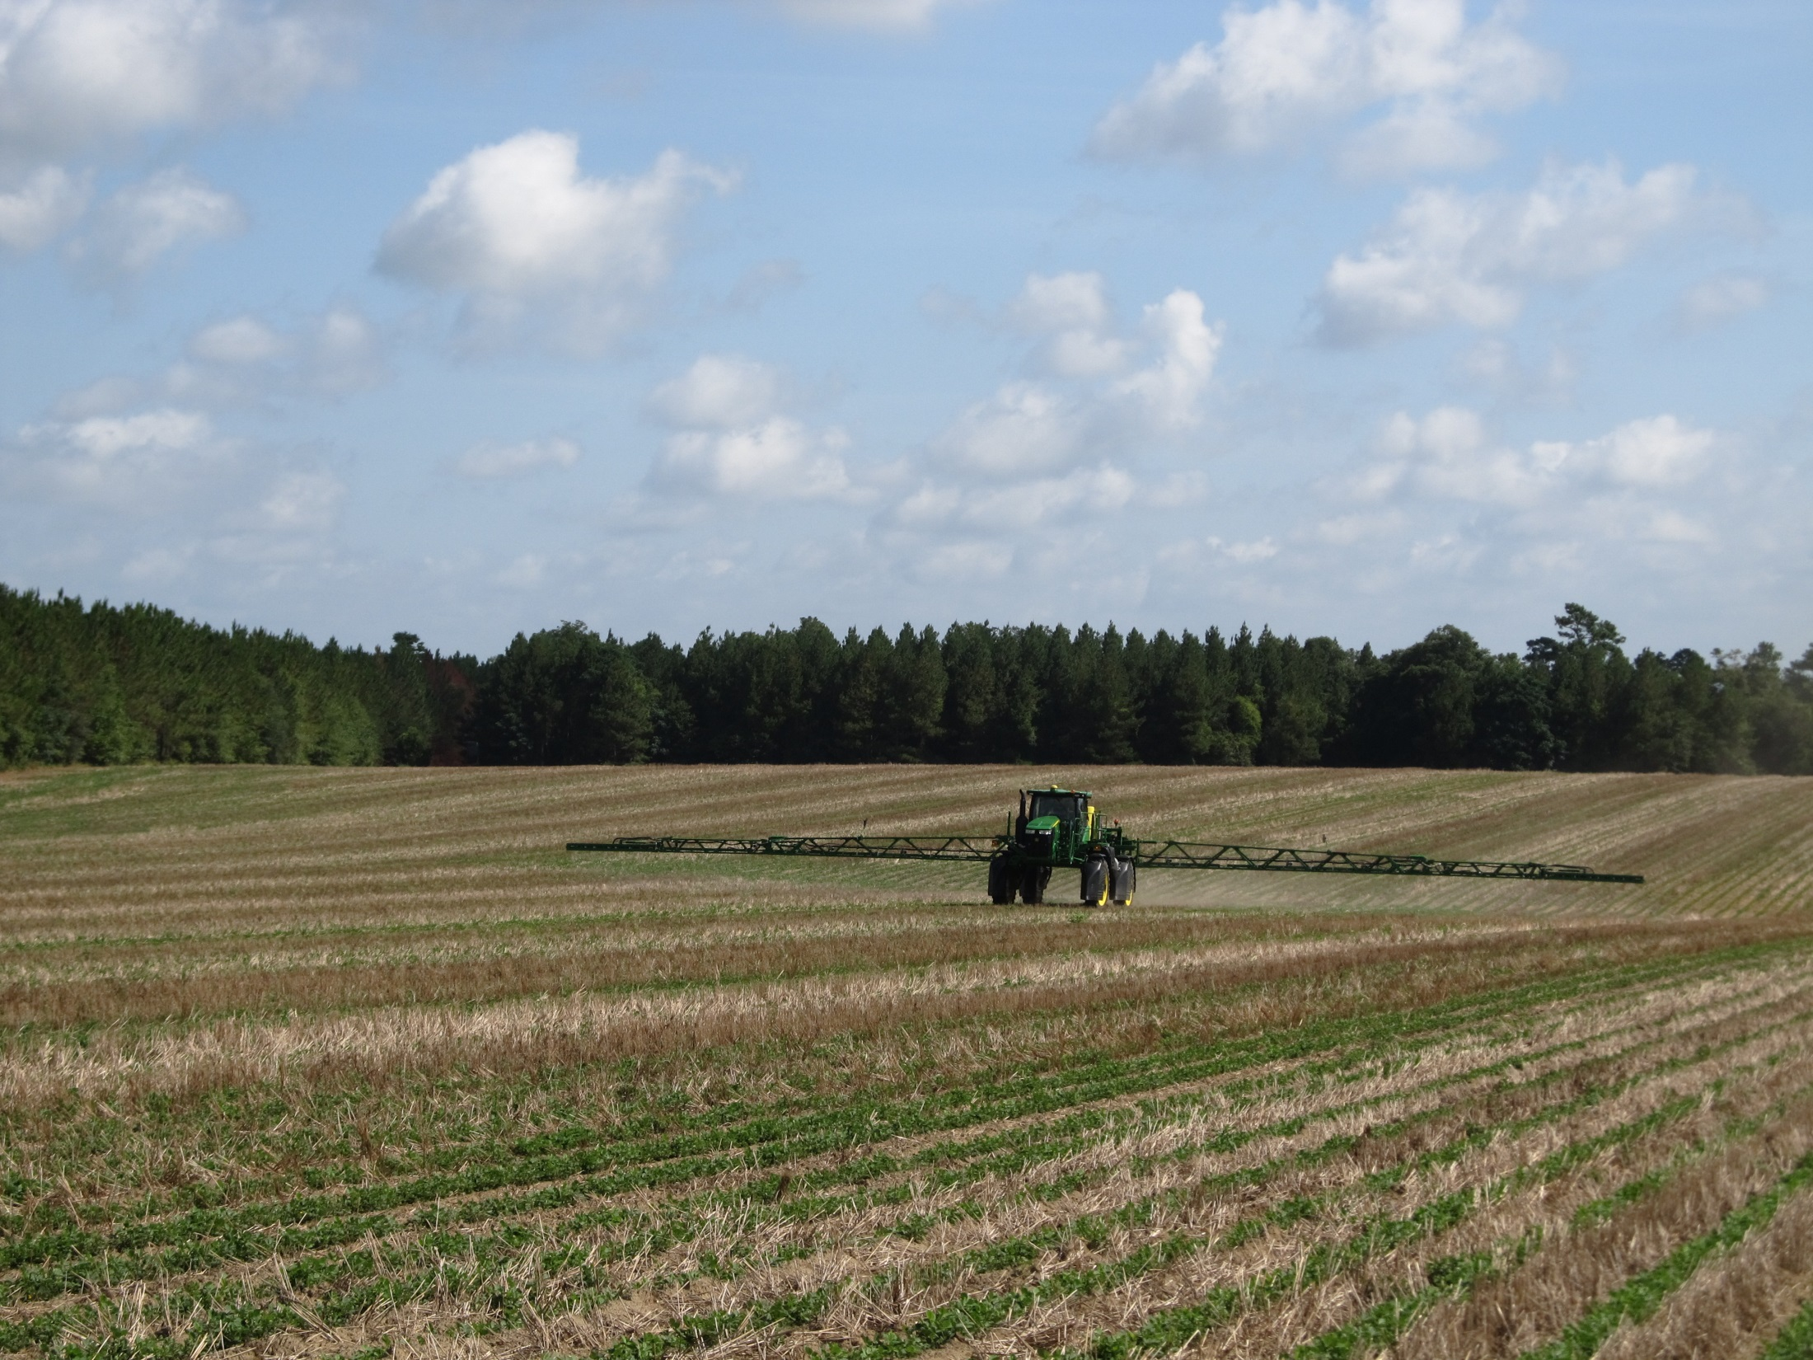
QUESTIONS?
eprostko@uga.edu
www.gaweed.com

